Slide 1
3D shape classification using Pointnet architecture
Experiment:

Slide 2
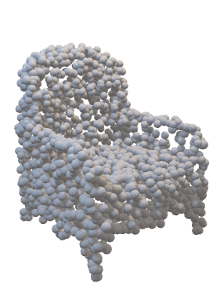
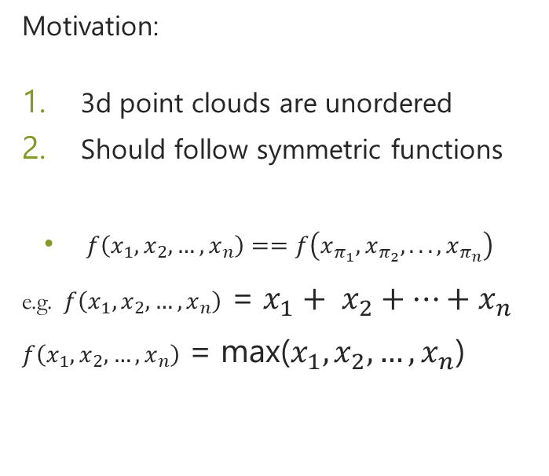
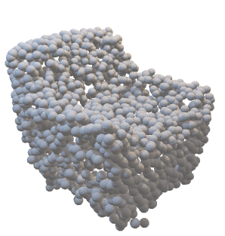
Introduction to Point clouds
Motivation:
3d point clouds are unordered
Should follow symmetric functions
$f\left(x_{1},x_{2},…,x_{n}\right)==f\left(x_{π_{1}},x_{π_{2}},...,x_{π_{n}}\right)$
e.g. $f\left(x_{1},x_{2},…,x_{n}\right)$ = $x_{1}+ x_{2}+…+x_{n}$
$f\left(x_{1},x_{2},…,x_{n}\right)$ = max($x_{1},x_{2},…,x_{n}$)

Slide 3
PointNet architecture (simplified)
output
input
conv1d
conv1d
conv1d
linear
linear
linear
Maxpool
3*N
64*N
128*N
1024*N
1024

Slide 4
PointNet architecture (simplified)
1024
3
N
N
1024
3*N
1024*N
Maxpool in this direction

Slide 5
Problem Statement
Objective: Point Cloud classification
Implementation must be from scratch using torch and NumPy.

